Slide 1
Financial Management Services Stakeholder Meeting
December 3, 2021

Slide 2
Agenda
OLTL Welcome
Updates from the Community HealthChoices Managed Care Organizations (CHC-MCOs)
Tempus Presentation
Q & A

Slide 3
Financial Management Services (FMS) Stakeholder Meeting FMS Vendor Transition for Self-Directed Services
Community HealthChoices
December 3, 2021

Slide 4
Agenda
FMS Transition
Presented by your Community HealthChoices MCOs: AmeriHealth Caritas PA CHC, Keystone First CHC, PA Health & Wellness, Inc., UPMC
AND Tempus Unlimited
Transition of Financial Management Services
What to Expect During the Transition
Transition Information Sessions
Payroll
EVV Training
Tempus Website
Questions

Slide 5
Transition of Financial Management Services

Slide 6
Transition of Financial Management Services
Participants who chose the Self-Directed Services Option work with a Financial Management Services (FMS) provider to serve as the Fiscal/Employer Agent (F/EA) to:
Enroll for self-directed services as the Common Law Employer (CLE) or their designated CLE
Process enrollments for Direct Care Workers (DCWs) they hire
Process payroll for DCWs
Manage tax related responsibilities
FMS responsibility for the Community HealthChoices program is now with the Managed Care Organizations (CHC-MCOs) as an Administrative function
CHC-MCOs selected HHAeXchange as the vendor with Tempus Unlimited as the Fiscal/Employer Agent
FMS will transfer from Public Partnerships LLC to Tempus Unlimited for payments processed on or after April 1, 2022

Slide 7
Transition of FMS - continued
Tempus is a non-profit corporation headquartered in Massachusetts
One of the largest Fiscal/Employer Agents in the country
Tempus board members and staff with disabilities bring lived experience to Tempus services
10+ years experience working in Managed Care
Tempus Mission
Tempus Unlimited exists to provide a continuum of community-based services that support the efforts of children and adults with disabilities to live as independently as possible in the least restrictive environment
Tempus will have three offices in Pennsylvania and remote staff located throughout Pennsylvania to assist Participants with self-directed services

Slide 8
What to Expect during Transition

Slide 9
What to Expect during Transition
Regular communication from Tempus
Transition Packets mailed to Participant/Common Law Employer
Common Law Employer (CLE) Transition Packet
Direct Care Worker (DCW) Transition Packet for each active DCW
Tempus Transition Information Sessions and Training
Call-in/Online Webex
In-Person
Tempus Training in 2022
Tempus EVV timesheet submission and approval process
Tempus Online Tools and Self-Service Portal
Tempus Enrollment Process

Slide 10
Transition Packets for Common Law Employers and Direct Care Workers
Tempus mailed pre-populated Transition Packets with information received from Public Partnerships LLC.
Packets mailed to the Common Law Employer’s address on file.
Participant/Common Law Employer Transition Packets include:
Cover Letter
CLE Enrollment Checklist
Common Law Employer Agreement *
IRS Form 2678 - Employer/Payer Appointment of Agent *
Tempus Notice of Privacy Practices
* Sign and Return; Requires signature of the CLE
Direct Care Worker Transition Packet sent for EACH of your DCWs. Packets include:
Cover Letter
DCW Enrollment Checklist
Direct Care Worker Agreement **
Direct Care Worker Information and Acknowledgement Form **
** Sign and Return; Requires signature of both the CLE and the DCW

Slide 11
Transition Packet Mailing Schedule
Transition packets mailed in phases based on CHC-MCO regions
Southwest Region – Mailed 11/2/2021
Southeast Region – Mailed 11/10/2021
Northwest/Northeast Region – Mailed 11/15/2021
Lehigh/Capital Region – Mailed 11/22/2021
Participants should expect to receive transition packets, CLE and DCW, within two weeks of the mailing date. If a transition packet is not received by Wednesday, 12/15/2021, email Tempus at PAFMS@tempusunlimited.org.
CLEs and DCWs should plan to attend a Transition Information Session for questions.

Slide 12
Transition Information Sessions

Slide 13
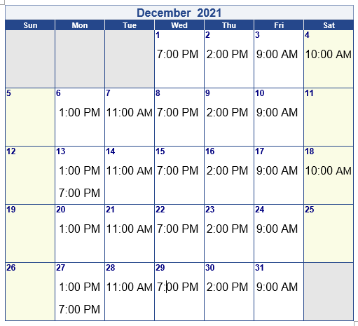
Call-in and Online Information Sessions
Tempus will host one-hour Call-in and Online WebEx sessions throughout the month of December to answer questions about transition and how to complete the transition paperwork.
Login Information included in transition packets and posted to the Tempus website at https://pa.tempusunlimited.org/.

Slide 14
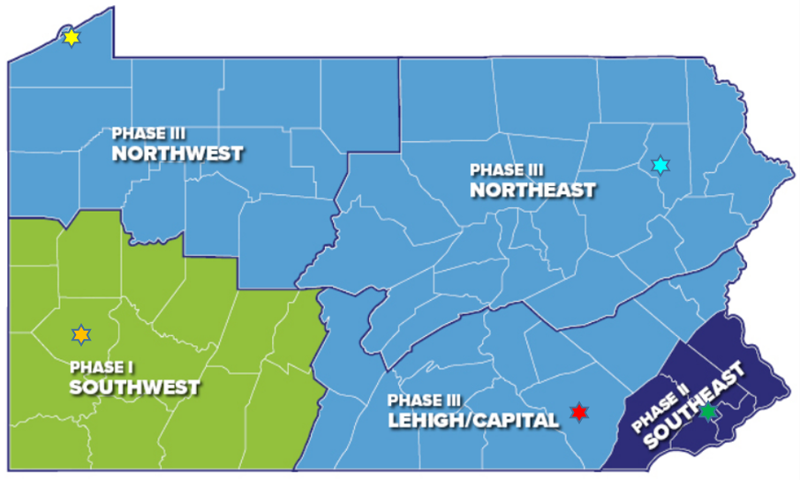
In-person Information Sessions
In-person Information Sessions for Common Law Employers and Direct Care Workers will be held in each region across the Commonwealth beginning in December. Sessions are drop-in sessions for CLEs and DCWs.
Schedule of dates and times has been posted on the Tempus website
Southwest – Pittsburgh
Southeast – Philadelphia
Northwest – Erie
Northeast – Clarks Summit
Lehigh/Capital – Lancaster
Notes:
Mention transportation benefit is available.

Slide 15
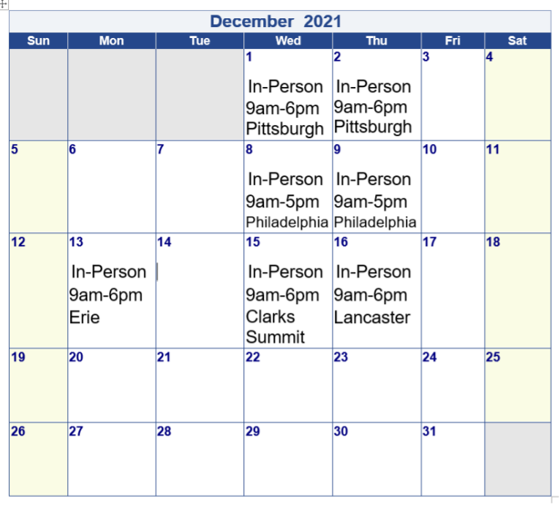
In-Person Information Sessions

Slide 16
Payroll

Slide 17
Payroll Timeline
Tempus will issue checks on or after April 1, 2022
Payroll schedules for Participants will remain the same
Participants on Schedule B with PPL
Services beginning with pay period 3/6–3/19/2022 will be submitted to Tempus
Payment date 4/1/2022
The payroll period of 3/20-4/2/2022 will be paid on 4/8/2022
Check dates will be every 2 weeks thereafter (4/22; 5/6; 5/20; etc.)
Participants on Schedule A with PPL
Services beginning with pay period 3/13–3/26/2022 will be submitted to Tempus
Payment date 4/1/2022
Check dates will be every 2 weeks thereafter (4/15; 4/29; 5/13; etc.)

Slide 18
EVV Timesheet Submission and Approval Process Training

Slide 19
Timesheet Submission & Approval Process
Electronic Visit Verification (EVV) requirements do not change. Changes to process include:
New app to clock in and clock out
New approval process for CLEs
Important information regarding Tempus user accounts:
All CLEs and DCWs must have a unique email address
CLEs and DCWs will need to provide Tempus their email address
To provide email address to Tempus, visit https://pa.tempusunlimited.org/ and click on the email survey link, answer the questions, and submit the form
Every Common Law Employer and Direct Care Worker will need to be trained.

Slide 20
Timesheet Submission & Approval Process
Beginning in 2022, Tempus will host multiple training sessions for CLEs and DCWs.
Training will be conducted through:
Call-in/Online WebEx Sessions
In-person Sessions
How-to Guides and Training Videos posted to the Tempus website
Training topics include:
How to download and use the Tempus EVV app to clock in and clock out
How to use the Tempus portal to submit time worked, edit a shift and create a manual entry
How to use Tempus phone system to clock in and clock out
How to approve or reject a shift
How to use the Tempus portal to view timesheet and payment information
How to obtain a user account to access the Tempus EVV app and Tempus portal

Slide 21
Tempus Website

Slide 22
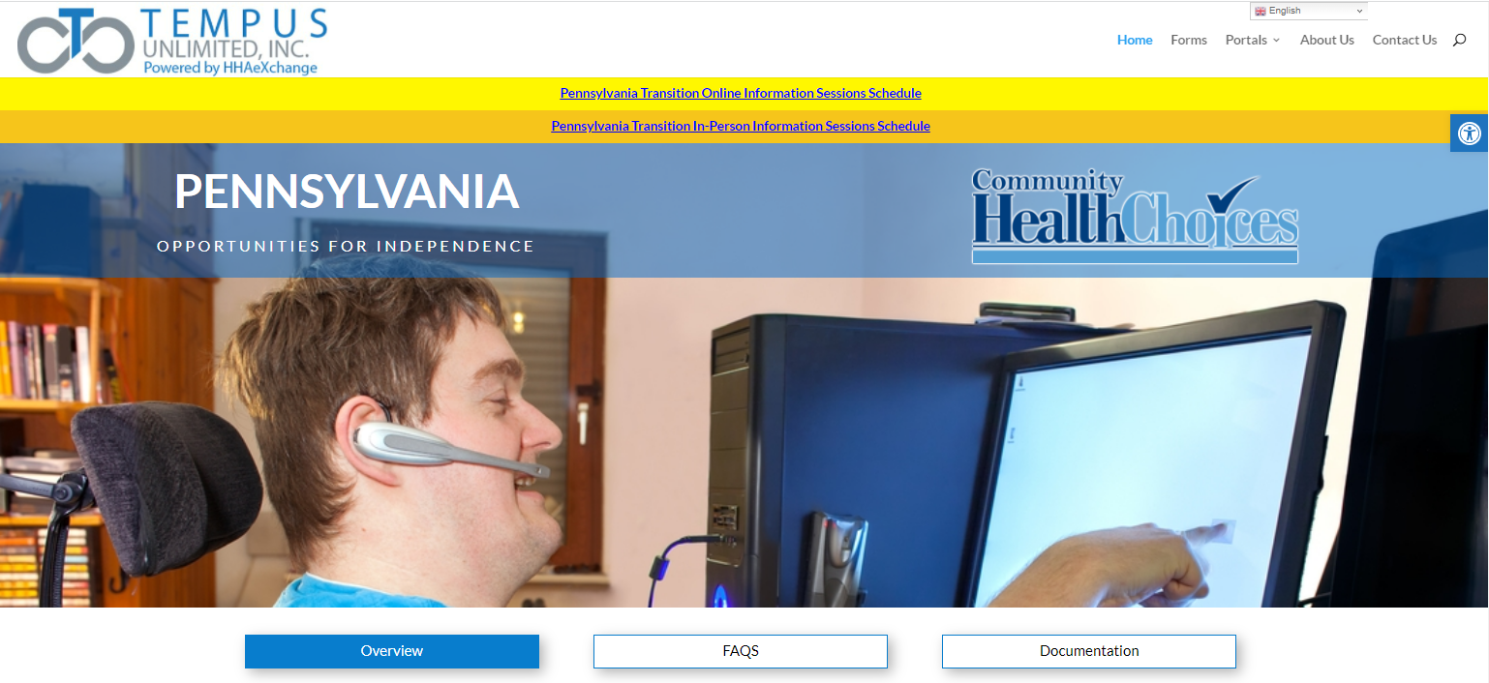
Tempus Informational Website
Website address: https://pa.tempusunlimited.org
This is your best source of information
Check Frequently: Information and updates from the CHC-MCOs and from Tempus will be posted to the Documentation section
Webinars and In-person sessions: Schedule posted with important webinars and in-person sessions to assist you with paperwork and to answer questions
The FAQs will be updated as we provide more information to Participants, Common Law Employers, and Direct Care Workers

Slide 23
Pennsylvania In-State Hiring Initiative
Tempus is looking to hire remote and in-office staff for Pennsylvania
Tempus is planning to open three offices in Pennsylvania
Pittsburgh Area
Central Pennsylvania
Philadelphia area
Individuals with lived experience or an understanding of self-direction would be valuable
Please check the Tempus website frequently for job openings:
Website: https://tempusunlimited.org

Slide 24
Questions?

